Slide 1
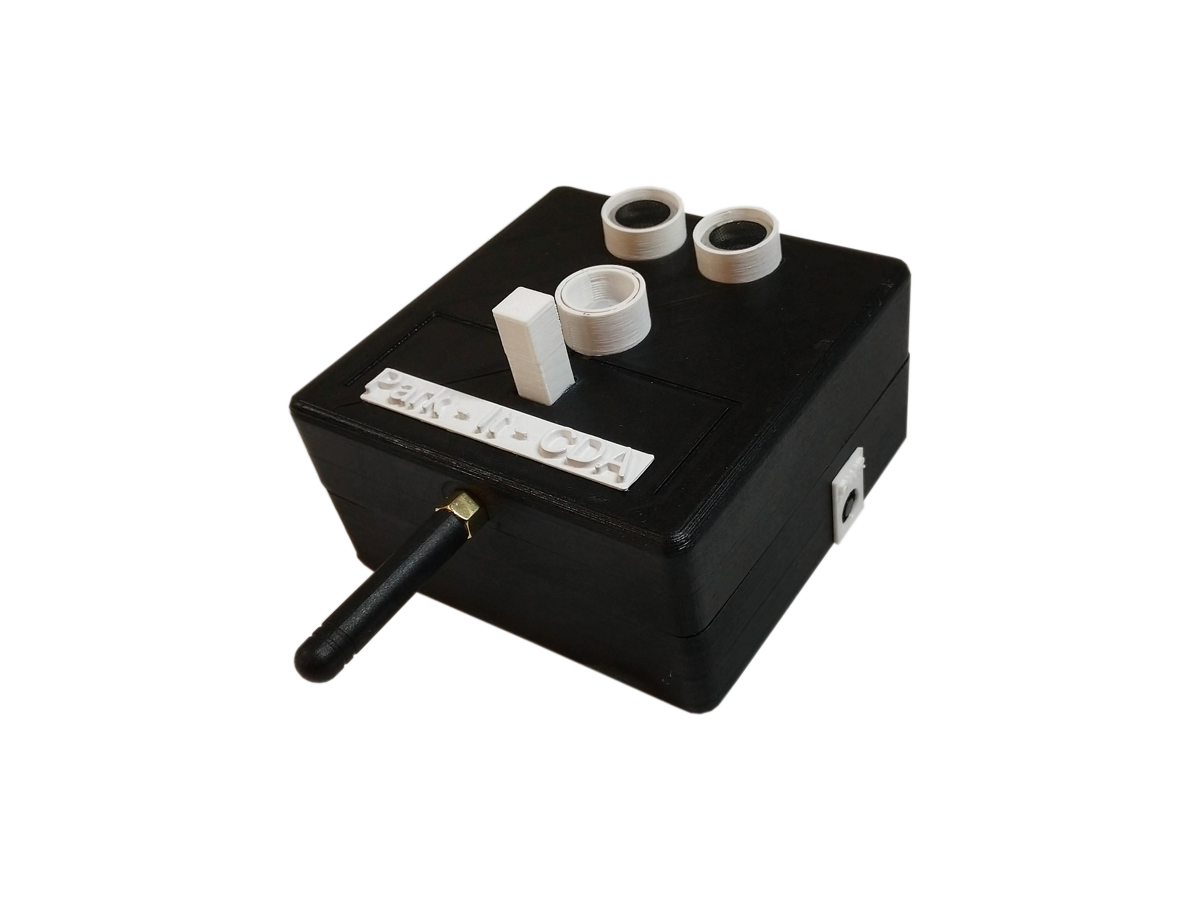
Park – It - Cda
A Garage sensor system over a mesh network

Slide 2
Value proposition
The problem
Too much time and effort are being spent by those looking for a place to park in one or more garages in downtown Coeur d’ Alene.
Our solution
A parking indication system
Vehicle sensing over stalls
LED indication to commuters
Mesh networking via detection/indication units

Slide 3
Objective and deliverables
Our goal
Outfit the parking garage in downtown CDA with 5 prototype units
Build a mesh network for units to relay stall status to a gateway at the Innovation Den
Build a simulation to show what a full-garage deployment would look like

Slide 4
Hard requirements
soft requirements
The units | The mesh network | The simulation
Enclosure no larger than 4” X 4” X 4” | Units relay messages to gateway at the den | representation of a full garage deployment
Sensors to detect presence of vehicles in stall | Data maintains integrity and authentication | Real time updates of stall status
Must last at least a year via battery power | Units are provisioned | Populated with accurate test data
LED to indicate stall status to commuters | Units are synchronized and can communicate with each other for message routing | Expandable for future projects
The units | The mesh network | The simulation
Redundancies of sensors for better accuracy | Units can choose a master and slave dynamically to save on battery | Graphical representation of system
Solar panels | Encryption of data | Companion app for phone/tablet
Security camera-like appearance for theft/tamper prevention |  | Data collection

Slide 5

Park – it - cda
Team members and roles
Nikolai Tiong
Tyrel Parker
Team leader
Mesh network
Simulation
Database
Zane Goodrick
Joel Berain
Encryption
Wiki Site
Unit Design
Sensor Prototyping

Slide 6
deliverables

Slide 7
planning
Selecting hardware and software
Board qualities
Sensors and LEDs
Mediums
- Deep sleep modes
- Low current usage for active and idle
- Low power, high range communication protocol
- Enough memory to handle Radiohead library and sensor libraries
- Accuracy
- Lightweight simulation software
- 3v3 Power supply to save battery
- Can interrupt processor
- RGB LEDs for ease and enclosure space

Slide 8
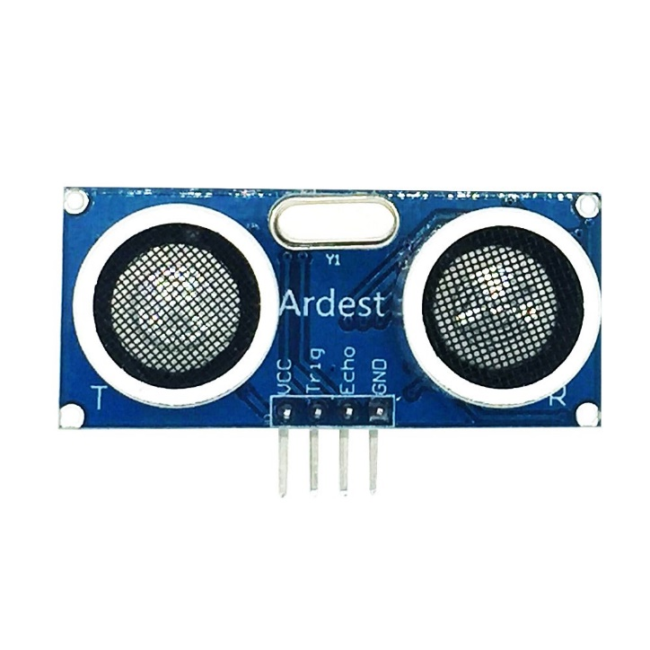
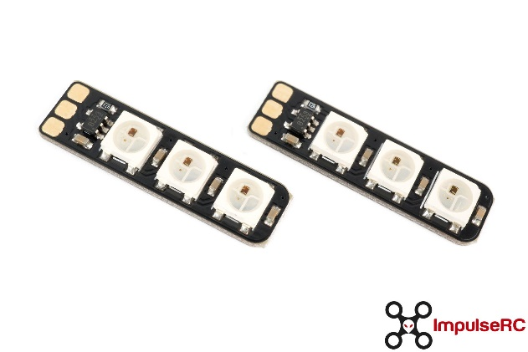
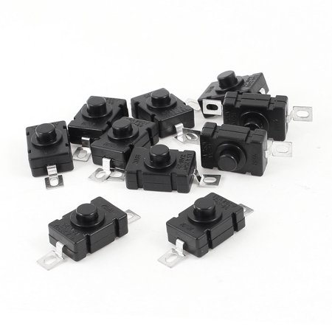
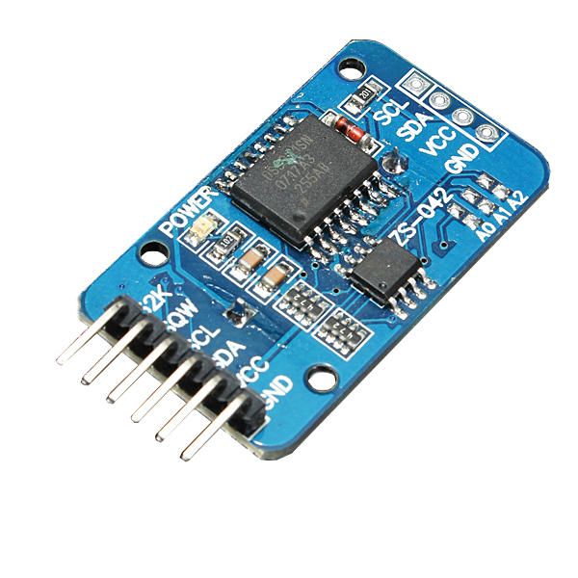
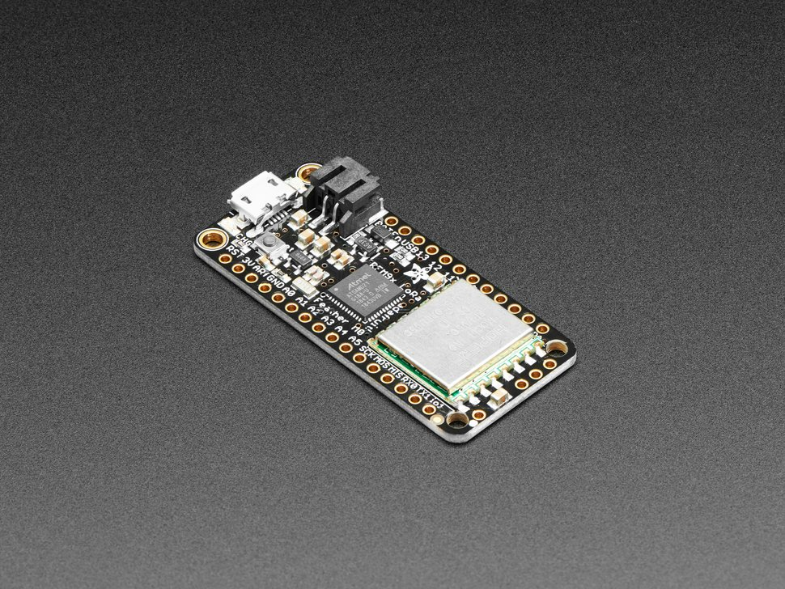
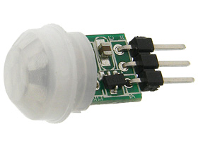
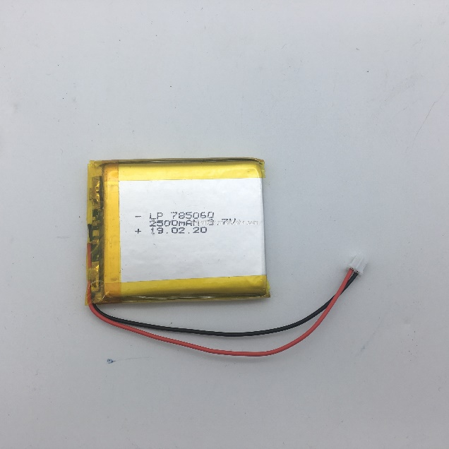
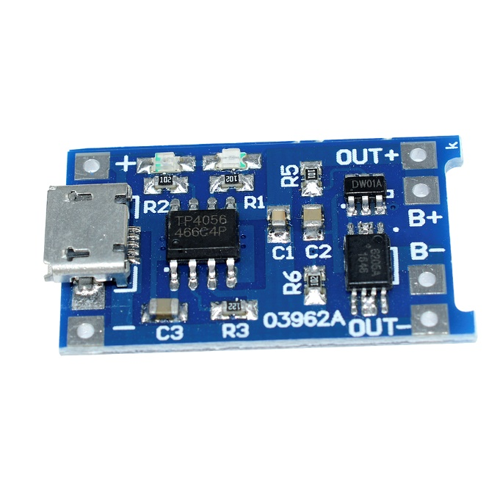
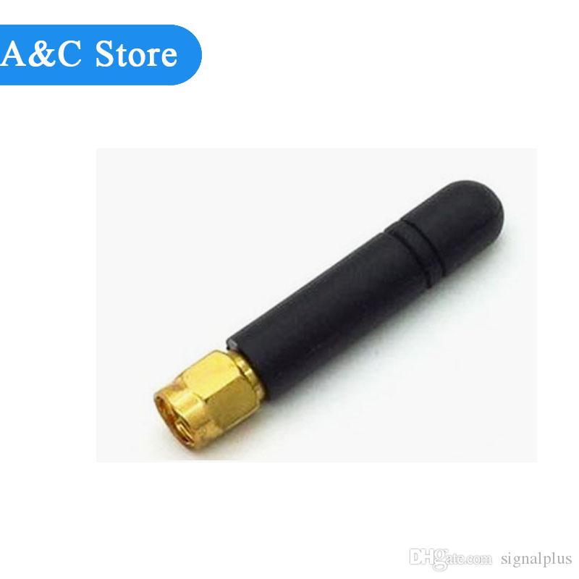
Components and mediums
The hardware
The Board
The Sensors
Other Components
HC-SR04 Ultrasonic Sensor
Adafruit Feather M0 LoRa
RGB LED
Locking Power Switch
Real-Time Clock
AM312 PIR Sensor
2500mah Lipo Battery
Lipo Charger
LoRa Antenna

Slide 9
Sensing vehicles
A combination of sensors are used to detect the presence of a vehicle
- The PIR sensor wakes up the CPU via external interrupt when a heat signature (vehicle) is detected below
- The ultrasonic sensor reads the distance to the ground 3 times to see if there is a blockage in the stall, outlying distances are thrown out in a 2 – to – 1 vote
- The processor changes the LED from green (vacant) to red (full)
- Stall status is sent periodically to the gateway over LoRa transmission

Slide 10
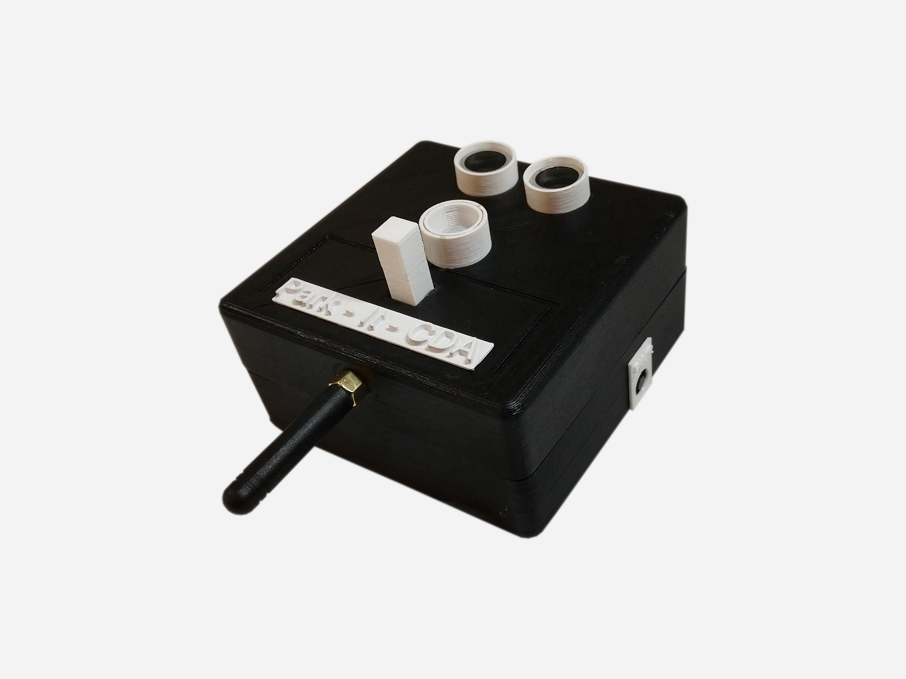
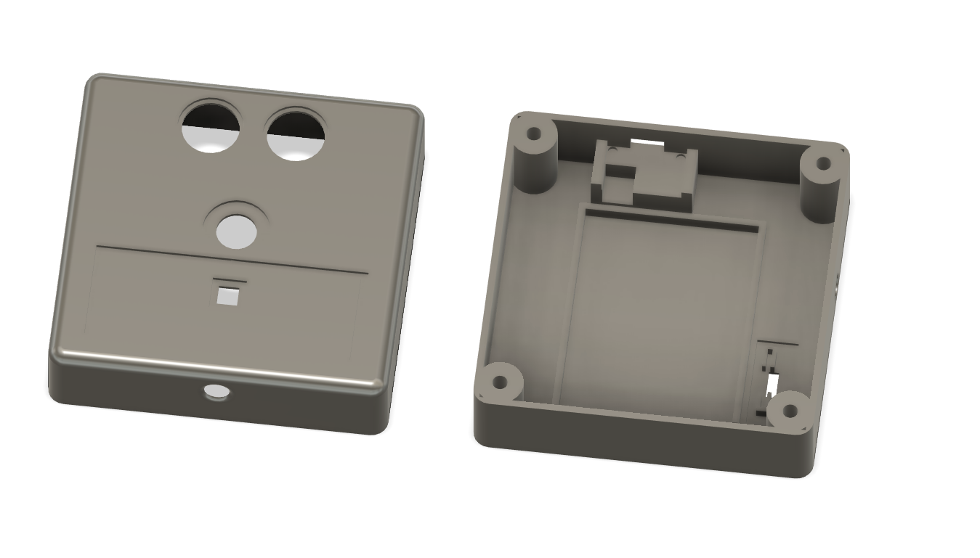
The Enclosure
Copper PIR limiter
Designing and 3d printing
Access to CPU and Lipo Underneath
LED diffuser
Final enclosure design, created in Fusion360
Full assembly of working prototype

Slide 11
Trials and lessons learned
Sensors and enclosure

Slide 12
Nikolai mesh networking
Font 48 for headlines
Font 36 for lists and other text

Slide 13
Tyrel Simulation
Font 48 for headlines
Font 36 for lists and other text

Slide 14
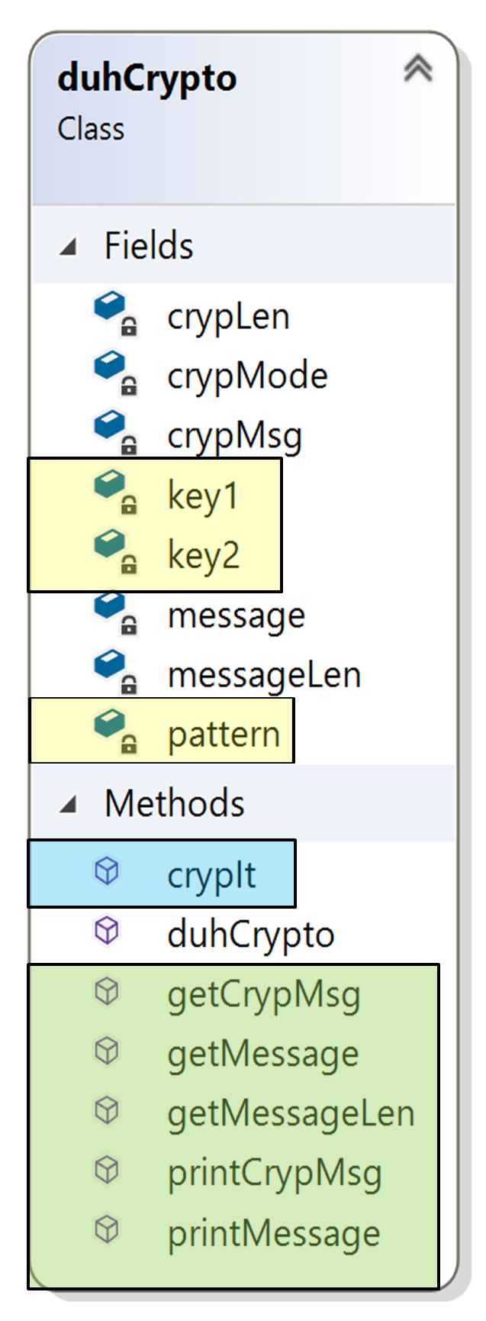



Encryption
A class was created to send and receive crypted data throughout our network. This class implements private key cryptography.
Two private keys and a predetermined pattern are used to encrypt and decrypt data
Encryption/Decryption method
Methods to access or print the original and crypted data

Slide 15
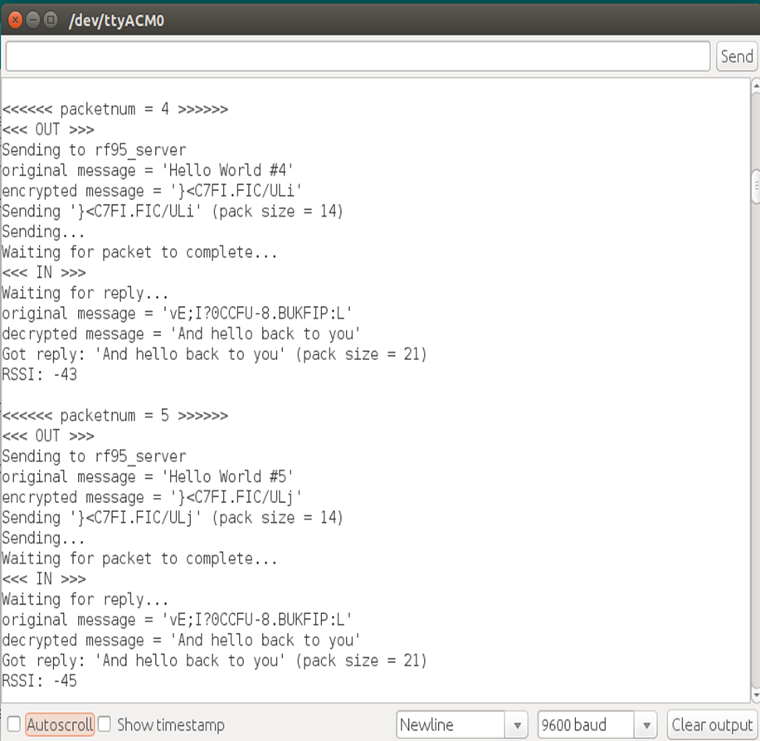
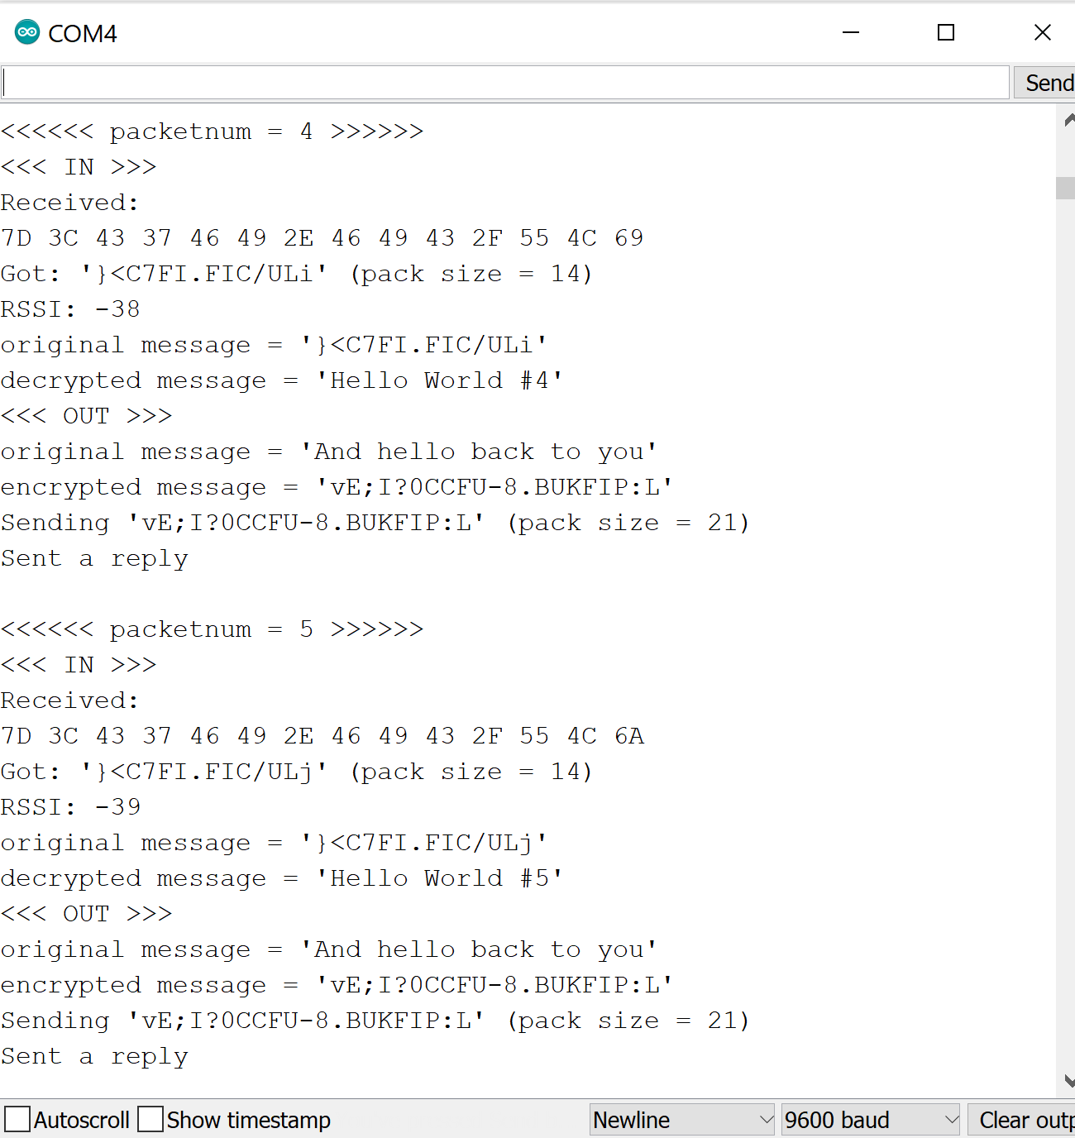


Encryption
(Example)
Client
Server

Slide 16
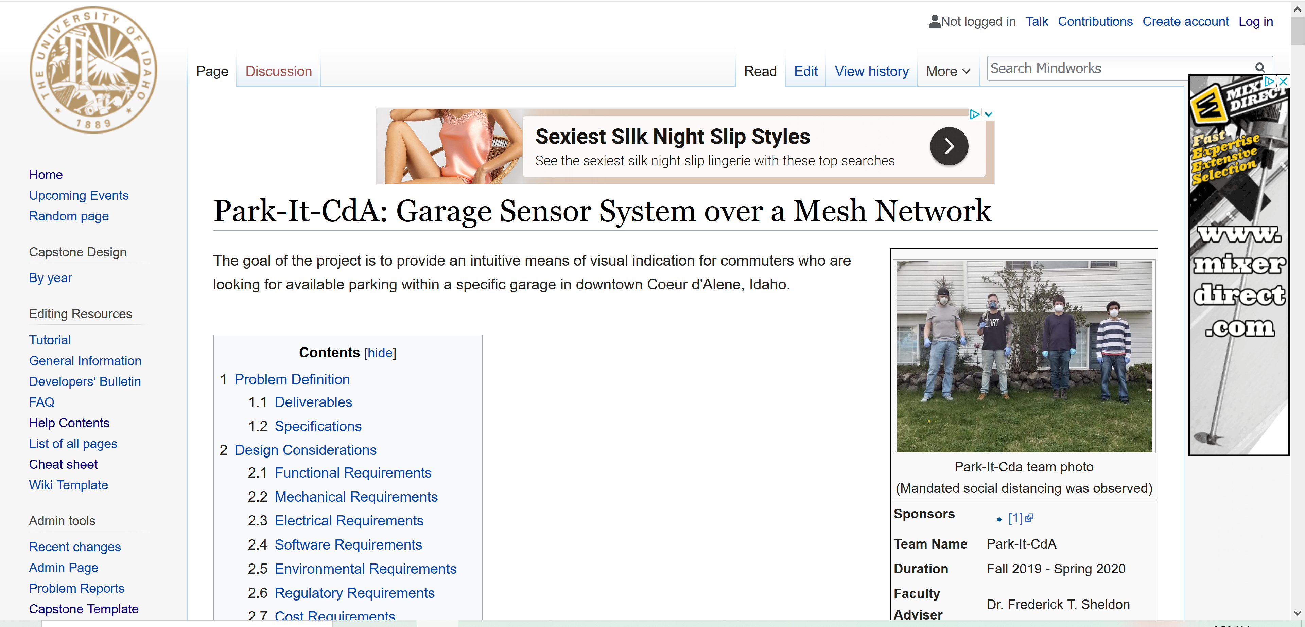
Wiki
Highlights the major components and the team’s lessons that were learned during the entire process
Provides more detail and additional documentation about our project
http://mindworks.shoutwiki.com/wiki/Park-It-CdA:_Garage_Sensor_System_over_a_Mesh_Network

